Slide 1
Part 2: SSDT Methodology & Features
for DB DevOps
Image by Dirk Wouters / Pixabay

Slide 2
Copyright © 2019 Madeira Ltd
All Rights Reserved
Full rights, including copyrights, belong exclusively to Madeira Ltd
No use of the materials, in any form, is allowed,
unless receiving a prior written permission from Madeira Ltd
Image by Dirk Wouters / Pixabay

Slide 3
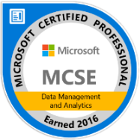
About Me…
Name: Eitan Blumin
Email: eitan@madeiradata.com
Twitter: @EitanBlumin
LinkedIn: www.linkedin.com/in/eitanblumin
Blog: www.eitanblumin.com
Notes:
Q: How to reach me?
Q: Where to find more resources? (blog)

Slide 4
Session Series Agenda
Part 1: Development Lifecycle Basics for DBAs
Part 2: SSDT Methodology & Features for DB DevOps
Notes:
Assuming we’re all on the same page in terms of development lifecycle basics

Slide 5
Part 2 - Agenda
What? (is SSDT)
How? (Methodology)
With what? (SSDT Tools and Features)
Wait, what? (Common issues)
CI and CD with SSDT
Notes:
Q: What questions will we answer in this presentation?

Slide 6
What is SQL Server Data Tools?
Available for Free from Microsoft
Set of tools and project types for Microsoft Visual Studio
Combination of Extensions and Add-Ons
SQL Database Project
BI Project Types (SSRS, SSIS, SSAS)
Utilities:
Schema and Data Compare
Refactoring
Unit Testing
Notes:
Q: What is SSDT?
Q: How is SSDT used? (VS)
Q: What is contained within SSDT?

Slide 7
Installing SSDT (Tools and Features)
Tools > Get Tools and Features…
https://docs.microsoft.com/sql/ssdt/
Notes:
Q: How to install SSDT’s SQL Project? (Tools > Get Tools and Features…)
Q: What does the SSDT extension contain?

Slide 8
Installing SSDT (Standalone)
https://docs.microsoft.com/sql/ssdt/
Notes:
Q: Where can we find the SSDT standalone installer?
Q: What does the SSDT standalone installer contain?

Slide 9
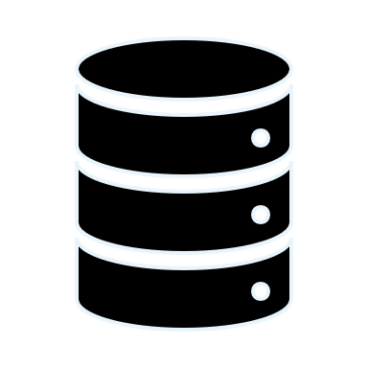
How? SSDT Methodology
Project = Database
Some support for server-level objects also exists
You can add “Database References” to your project, for cross-database code dependencies
Notes:
Q: What does each project in SSDT represent?
Q: What if we want to have source control for server-level objects?
Q: What if your code uses other databases or linked servers or system objects?

Slide 10
How? SSDT Methodology
Each Object = Separate SQL Script File
More accurately: Separate SQL batch per object
This allows granular work and Version History in Source Control
Notes:
Q: How is Source Control actually implemented in SQL DB Project?
Q: How does it allow better collaborative work and auditing?

Slide 11
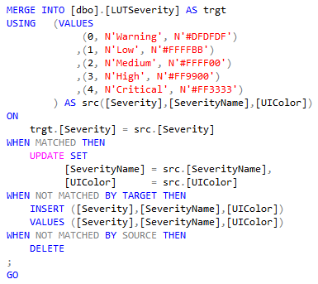
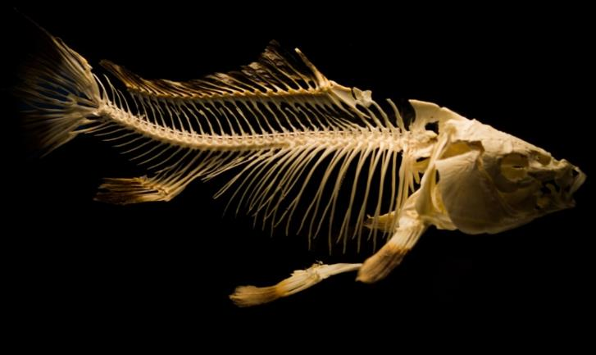
How? SSDT Methodology
Schema Only, No Data
There are ways to circumvent that, though, using the Post-Deployment scripts
sp_generate_merge:
https://github.com/readyroll/generate-sql-merge
Image by Rudy and Peter Skitterians / Pixabay
Notes:
Q: What is actually saved in a SQL DB Project? Q: What if we want to have source control for data as well?

Slide 12
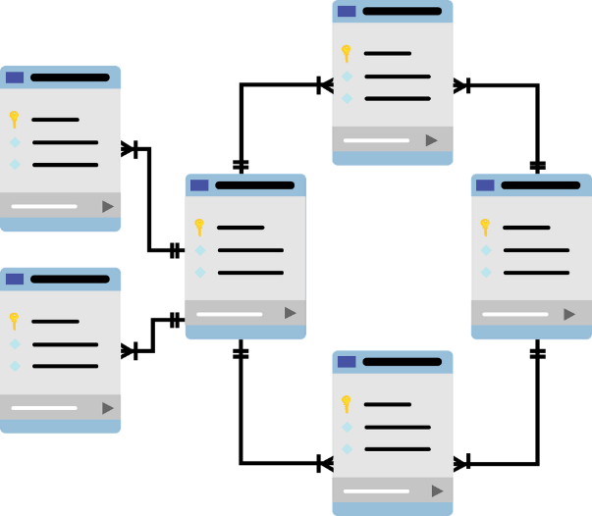
How? SSDT Methodology
Transact-SQL Compiler Service
SSDT Constructs a “Model” of the database.
Builds and compiles DB objects inside Visual Studio in design-time, with referential integrity, without needing to deploy to a DB
Design-time error detection
Image by mcmurryjulie / Pixabay
Notes:
Q: What is the T-SQL Compiler Service? What does it do and how?
Q: What is the benefit of having it in SSDT?

Slide 13
How? SSDT Methodology
Deployment Artifact: DACPAC File
XML formatted
Deployed using SQLPackage.exe
Most useful in CI/CD pipelines, but other forms of deployment are also available:
Clean DB Creation script (drop + create from scratch)
Manual deployment using Visual Studio
Publish script generation for later use
Schema Compare tool
Notes:
Q: What is the Build output of a SQL DB Project?
Q: What is a DACPAC file?
Q: How is it used?
Q: What other methods for deployment can we use in SSDT?

Slide 14
How? SSDT Methodology
State Based: (SSDT, SqlPackage.exe)
State-Based Deployment
Single Source of Truth (Desired End State)
Pre/Post Deployment scripts, and the Refactor tool can be used to simulate semi-Migration-Based methodology
Schema Compare
DACPAC / DB Project
database
Execute
Migration based: (NOT SSDT)
Diff / Publish Script .sql
Init .sql (v1)
Diff .sql (v2)
Diff .sql (v…)
Diff .sql (latest)
Notes:
Q: How is SSDT intended to be used?
Q: What is State-Based Methodology?
Q: What is Migration-Based Methodology? What are example tools that use it?
Q: What are the advantages of each methodology?
Q: How can we use SSDT to solve issues inherent in State-Based that are solved in Migration-Based?

Slide 15
How? SSDT Methodology
Publish Script Format: SQLCMD
Built-in SQLCMD Variables:
$(DatabaseName)
$(DefaultDataPath)
$(DefaultLogPath)
$(DefaultFilePrefix)
You can add more SQLCMD Variables
The SQLCMD Variables can be used anywhere in your database project
Also used for cross-database references
https://docs.microsoft.com/sql/tools/sqlcmd-utility
Notes:
Q: How is a Publish script executed?
Q: What are the benefits of SQLCMD?

Slide 16
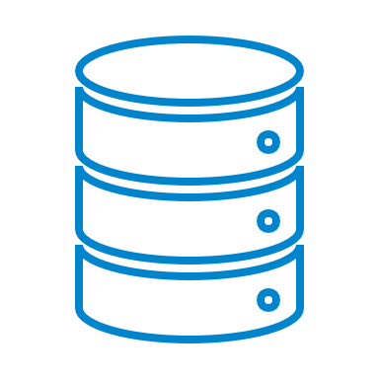
How? SSDT Methodology
Preferable Decoupled / Isolated Development
DB development should mainly be done within Visual Studio
Each developer works against their own local database
No “shared development” database server
Never develop directly on a production server
Integration / Build tests should be continuous
Based on source-control commits
Build
Test
QA
Staging
Production
Shared Source Control
Developers
Continuous Integration
Notes:
Q: What is the ideal / preferable development methodology with SSDT?

Slide 17
SSDT Methodology: Summary
Project = Database
Object = SQL Script File
Schema Only, No Data
Design-Time Compiler Service
Deployment Artifact: DACPAC File
State-Based Deployment
Publish Script Format: SQLCMD
Preferable Decoupled / Isolated Development
Notes:
Recap

Slide 18
Let’s see it in action
Notes:
More of a “tour” around the features.
Create a new empty SQL Database Project
Import a Database that contains referential integrity errors
Review the Errors window pane
Use the Refactor tool to rename an object or column
Review Publish options
- Hands-on topics:
- Visual Studio Feature Installation
- Visual Studio Extensions (SSRS, SSIS, ...)
- First-time DB schema import
- Compile Errors
- Cross-DB Table Synonyms (bug)
- Data initialization (sp_Generate_Table_Merge)
- Cross-DB reference/dependency
- CLR assembly development
- SQLCMD (Pre-Compiler) Parameters
- Publish profile settings

Slide 19
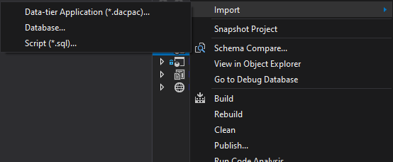
Import Database Project
Notes:
Q: How to create your first SSDT project?
Q: What are possible sources for database import?
(this is a replacement slide for a live demo)

Slide 20
Database Reference
DB Sources: sqlproj, master/msdb,dacpac
DB Locations
SQLCMD Variables
Error Suppression
Notes:
Q: What are possible database reference sources? (projects, system database, dacpac)
Q: What are possible database locations? (same database same server, different database same server, different database different server)
Q: How are SQLCMD Variables utilized in database references?
Q: Why suppress or not to suppress unresolved reference errors?
(this is a replacement slide for a live demo)

Slide 21
CLR Development & Reference
Aggregates
Procedures
Triggers
Functions
Types
Notes:
SQL CLR objects can also be created within the project
(this is a replacement slide for a live demo)

Slide 22
SQL Server Query Editor
Connects to live databases
SSMS-Like
Keyboard shortcuts are a bit different
Notes:
Q: What is the SQL Server Query Editor in SSDT?
Q: What can it be used for?
(this is a replacement slide for a live demo)

Slide 23
SQL Server Object Explorer
SSMS-Like
Unit Tests
Refactor Tool
Notes:
Q: What is the SQL Server Object Explorer in SSDT?
Q: What can it be used for?
(this is a replacement slide for a live demo)

Slide 24
Refactor Tool
Rename
Move to Schema
Fully-Qualify Names
Expand Wildcards (*)
Notes:
Q: What is the Refactor tool in SSDT?
Q: What can it be used for?
(this is a replacement slide for a live demo)
https://docs.microsoft.com/en-us/sql/ssdt/how-to-use-rename-and-refactoring-to-make-changes-to-your-database-objects?view=sql-server-ver15

Slide 25
Database Unit Testing
default
Notes:
Q: What are Unit Tests in SSDT?
Q: What kind of control do we have in those unit tests?
Q: What kind of test conditions can we use?
Read more: https://docs.microsoft.com/sql/ssdt/using-test-conditions-in-sql-server-unit-tests
(this is a replacement slide for a live demo)

Slide 26
Schema Compare
Notes:
Q: How to perform Schema Compare in SSDT?
Q: What kind of options and settings can we control?
Q: What kind of sources and targets can we use for comparison? (project, database, dacpac)
(this is a replacement slide for a live demo)

Slide 27
Data Compare
Notes:
Q: How to perform Data Compare in SSDT?
Q: What kind of options and settings can we control? (none, besides choosing what to compare and apply)
Q: What can be used in data comparisons? (live tables and views with PK/unique keys)
Read more: https://docs.microsoft.com/sql/ssdt/how-to-compare-and-synchronize-the-data-of-two-databases
(this is a replacement slide for a live demo)

Slide 28
Publish Database
Notes:
Q: How to publish a database?
Q: What kind of options and settings can we use?
Q: What are Publish Profiles?
Q: What does it mean to register as a Data-tier Application?
(this is a replacement slide for a live demo)

Slide 29
SSDT Features: Summary
Creating Database Project using Import
Database Reference (user / system DB)
SQL CLR Development
SQL Server Object Explorer, SQL Query Editor
Refactor Tool
Rename
Move to Schema
Fully-Qualify Names
Expand Wildcards (*)
Unit Tests
Schema and Data Compare
Publish Profiles
Notes:
Q: What have we covered?
Q: What else is there? (CLR, BI Projects)

Slide 30
Wait, what? Common Issues
Problem
Solution
Compilation errors due to object reference errors
Reference errors to other databases or to system objects
Reference errors with Synonyms to another database
Unsupported changes/object types
Data Init Source Control
Fix object names; Remove local database from 3-part names
Add Database Reference (support for linked servers too)
Add both databases, using same .NET framework version and compatibility, re-create database references. Recreate as View as workaround.
Use Pre/Post-Deployment Scripts
Image by Gerd Altmann from Pixabay
Notes:
Q: What are common problems encountered when first starting to use SSDT?
Q: How to solve them?

Slide 31
Wait, what? Common Issues
Keep in mind:
Some abnormal deployment use cases may be easier to implement using traditional, manual migration scripts, rather than working around SSDT limitations.
SSDT would still be ideal for common daily development.
Manual Deployment
DBA
Production
Desired State
CI/CD
SSDT Source Control
Notes:
Q: What are common problems encountered when first starting to use SSDT?
Q: How to solve them?

Slide 32
CI and CD with SSDT

Slide 33
SqlPackage.exe
SqlPackage.exe /Action:Publish /SourceFile:”MyDB.dacpac” /Profile:”MyDB.publish.xml"
Compares dacpac to database
Generates a deploy (diff) script
Runs Pre-deployment script
Runs deploy script (generated in step 2)
Runs Post-deployment script
If not exists: CREATE DATABASE
MyDB_XX.publish.sql
Icons by Vectors Market / flaticon.com
https://docs.microsoft.com/sql/tools/sqlpackage
Notes:
Q: How is a DACPAC actually deployed?
Q: How to use SqlPackage.exe?
Q: What are the steps in DACPAC deployment?
Q: Why is this order of steps important, and how can we utilize it for our benefit?
Read more:
Using “pre-pre-deployment” scripts to run something before the compare phase: https://the.agilesql.club/2015/07/pre-compare-pre-deployment-scripts-to-ssdt/

Slide 34
CI/CD with SSDT - The Important Part
MSBuild.exe – Builds the project and generates DACPAC
SqlPackage.exe – Deploys DACPAC to a target DB
MSTest.exe / VSTest.Console.exe – Execute Unit Tests
https://docs.microsoft.com/visualstudio/msbuild
https://docs.microsoft.com/sql/tools/sqlpackage
https://docs.microsoft.com/visualstudio/test/vstest-console-options
Everything else is a wrapper.
Speak with your DevOps team!
Notes:
Q: This is what’s important for the DevOps team to know

Slide 35
Next Steps:
Install SSDT:
https://docs.microsoft.com/sql/ssdt/
Import Database(s) into new Project
Sample SSDT Project to play around with: https://github.com/EitanBlumin/wwi-ssdt/
Fix Build Errors
Database References
Refactor
Add to Source Control
Add to CI/CD Pipeline
TEST !!!
Still having trouble? Let us help you with it!
www.MadeiraData.com/Solutions
Image by Dirk Wouters from Pixabay

Slide 36
Questions?
Image by David Castillo Dominici / FreeDigitalPhotos.net Image by Dirk Wouters from Pixabay

Slide 37
Keep in touch…
Name: Eitan Blumin
Email: eitan@madeiradata.com
Twitter: @EitanBlumin
LinkedIn: www.linkedin.com/in/eitanblumin
Blog: www.eitanblumin.com
Also in:
www.madeiradata.com

